Slide 1
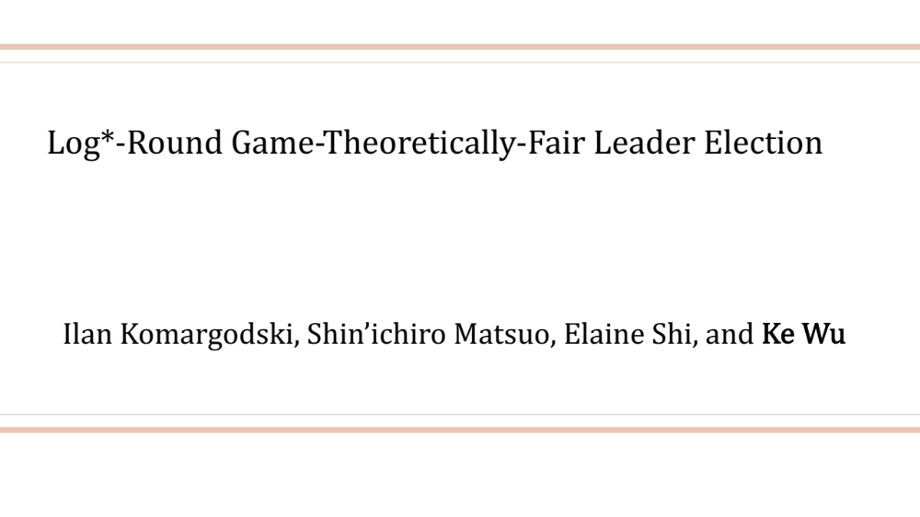
Log*-Round Game-Theoretically-Fair Leader Election
Ilan Komargodski, Shin’ichiro Matsuo, Elaine Shi, and Ke Wu
Notes:
Talk about strong fairness first?

Slide 2
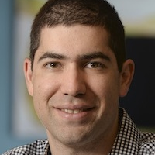

Who will present the paper?
Ilan Komargodski
Ke Wu
Notes:
Ilan and I need to decide who will go present the paper at CRYPTO. both of us want to go and enjoy the beautiful beach in santa babara. so we decide to toss a random coin. If the output is 0, Ilan will go present the paper and if the output is 1, I will go present the paper.
You probably already know the result, but let me tell you the whole story

Slide 3


[Blum 83]
Notes:
Since we are in different city, we decide to do Blum’s coin toss protocol on blockchain.
We each choose a random bit and post the commitment of the random bit on the blockchain. If you are not familiar with blockchain, you can think of it as a public bulletin board. So after we post the commitment, everyone can see them on the blockchain.

Slide 4




1
$$⊕$$
0
=
Outcome 1
[Blum 83]
Notes:
After we both post the commitments. we each open our random bit and post the opening on blockchain. Let’s say my bit is 0 and Ilan’s bit is 1. The output will be the xor of these two bits, which is 1. So I win and here I am.

Slide 5


0
Outcome 1
[Blum 83]
Notes:
However, Ilan really want to go to the beautiful beach in SB. After I post my bit on the blockchain, Ilan knows that he's gonna lose the game if he opens his bit. What if Ilan refuse to open his commitments? In this case, I just automatically wins and the output will be 1.
This is the famous Blum’s coin toss protocol. it guarantees that a strategic player like Ilan cannot bias the output towards his preference.

Slide 6
Coin toss protocol
Correctness: if all honest, output is uniformly random.
Strong fairness: strategic player cannot bias the output.
Impossible due to [Cle86]
Notes:
Formally, in a coin toss protocol, the goal is to toss a random coin. The fairness notion considered in traditional crypto literature is called strong fairness, or unbiasability, which requires that a strategic player cannot bias the output towards either direction, Unfortunately, this is shown to be impossible with polynomially many rounds against majority sized coalition by Cleve in 1986. Indeed, even in Blum’s coin toss we just saw, Ilan can always bias the output towards 1 by refusing to open the commitment. The fairness achieves by Blum’s protocol is more of a game theoretical favor.

Slide 7
Coin toss protocol
Correctness: if all honest, output is uniformly random.
Game-theoretic fairness:
1. strategic player cannot benefit itself.
2. honest player cannot be harmed.
Notes:
It guarantees that a strategic player cannot benefit herself, nor can it harm an honest individual by deviating from the protocol. Now that Blum’s coin toss protocol achieves game-theoretic fairness for two-party coin toss, a natural question to ask is can we generalize this to n party.

Slide 8

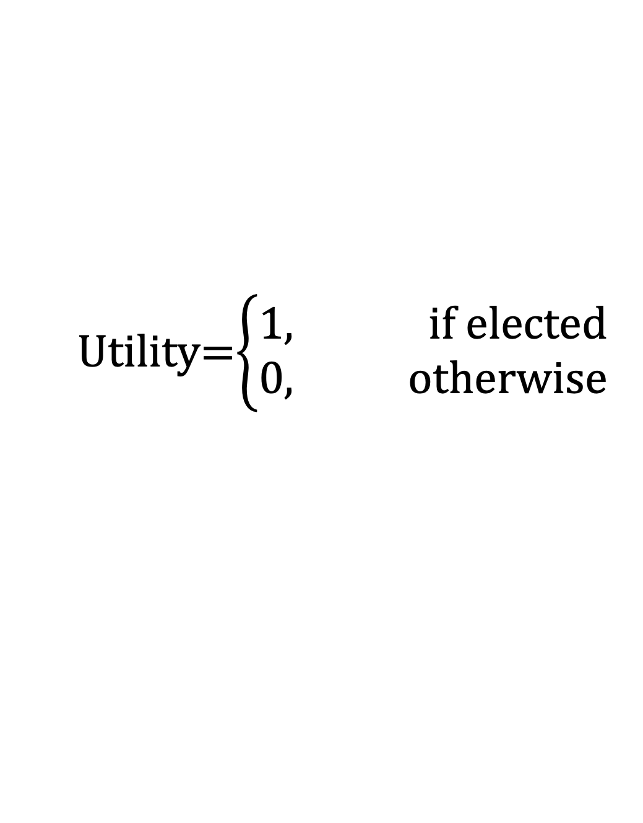
Multi-party leader election
Shafi Goldwasser
Dan Boneh
Brent Waters
Yael Kalai
Utility=$\left\{\begin{aligned}1, if elected \\ 0, otherwise\end{aligned}\right.$
Notes:
When it comes to multiple party, the problem becomes leader election. Suppose we are electing the next CRYPTO PC chair.
In leader election, our goal is to elect a random leader, and the utility is “winner takes all”. The winner has utility 1 and everyone else has utility 0.
Although there’s a lot of work to do, everyone wants to serve our community so everyone wants to be elected.
Some of the players may form a coalition and they want to bias the output towards their favor to increase their joint utility, whereas the joint utility of a coalition is 1 if the elected leader is in the coalition and 0 otherwise.

Slide 9
Leader election protocol
Correctness: if all honest, the leader is chosen uniformly at random.
Game-theoretic fairness:
1. No coalition can increase its expected utility.
2. No coalition can harm any honest individual.
Honest behavior is an equilibrium!
Notes:
In the leader election problem, the game theoretic fairness is a little bit different. Here we require that a coalition cannot increase its expected utility nor harm any honest individual.

Slide 10
Why we care about game-theoretic fairness?
Strong fairness is impossible against majority sized coalition.
Want fairness against majority sized coalition.
Notes:
In many decentralized applications/blockchain, game-theoretic fairness is actually the de facto approach. Game theoretic designs are used in many decentralized applications, although sometimes without provable security in practice but this is the notion that people want to have
From now on when I say fairness I always mean game theoretic fairness

Slide 11
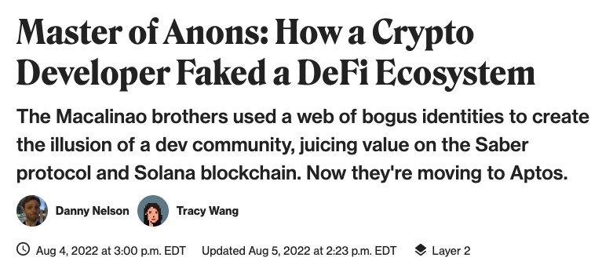
Why we care about corrupted majority?
Notes:
In many decentralized applications, for example, voting on blockchain, many pseudonyms may be controlled by a same entity. And these pseudonyms will coordinate together and they may deviate from the protocol to gain benefit. It is very likely that these pseudonyms form a majority sized coalition.
Actually this forging pseudonym attack is a real-world attack that happens only a few days ago, where someone controlling a lot of pseudonyms destroying Defi ecosystem.
So we do need some meaningful fairness against majority sized coalition in decentralized applications

Slide 12

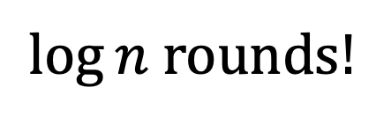
Tournament tree protocol
$\log{n}$rounds!
Notes:
A classical way to do game-theoretically fair leader election is tournament tree protocol, where each pair of players duel with each other using the Blum’s coin toss, and the winner duel with each other again, till there is only one winner. This tournament tree protocol guarantees game theoretic fairness because of the Blum’s coin toss. But it takes log n rounds for n players.

Slide 13


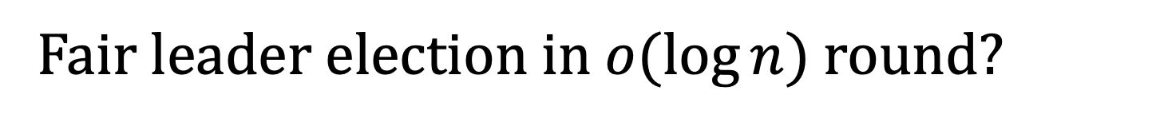
Fair leader election in $o(\log{n})$ round?
Impossible if perfect game-theoretic fairness
1. No coalition can increase its expected utility.
2. No coalition can harm any honest individual.
In the ideal commitment model.
[CCWS21]
[GGS22]
Notes:
Thus, a natural question to ask is that, can we reduce the round complexity?
Here we have both good news and bad news
The bad news is that previous work showed if we insist on perfect fairness and in the commit only model, then log n rounds is necessary.

Slide 14

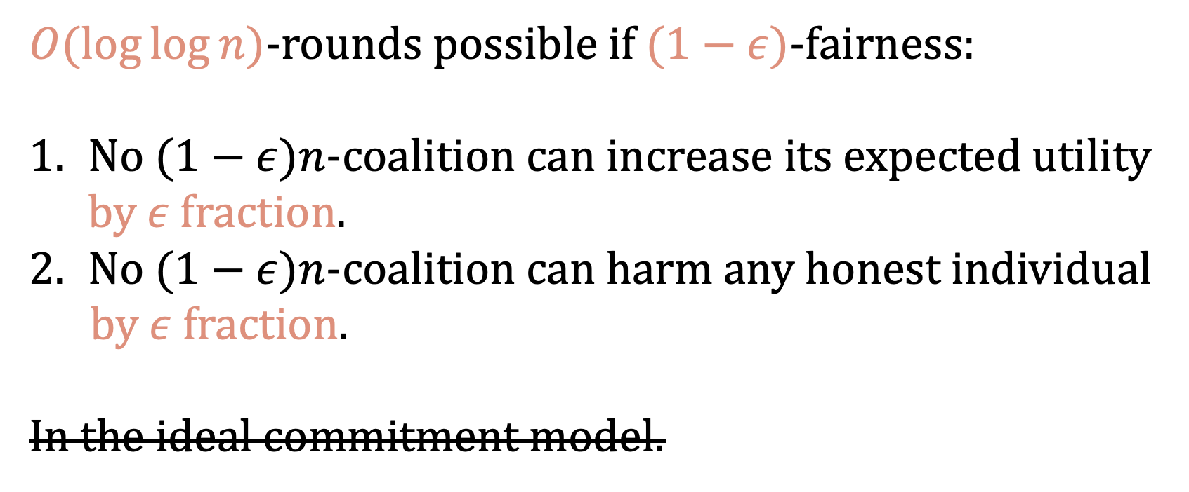
Fair leader election in $o(\log{n})$ round?
$O(\log{\log{n}})$-rounds possible if $(1−ε)$-fairness:
No ($1−ε)n$-coalition can increase its expected utility by $ε$ fraction.
No ($1−ε)n$-coalition can harm any honest individual
by $ε$ fraction.
In the ideal commitment model.
[CCWS21]
Notes:
The good news is that, if we are willing to relax the fairness notion to (1-\epsi)-fairness, which requires that no (1-\eps) fraction of corrpupted players can increase its expected utility by more than eps fraction,
and use other cryptographic primitives, then [CCWS21] show that we can do loglog n rounds, for eps = o(1).

Slide 15


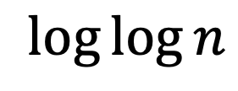
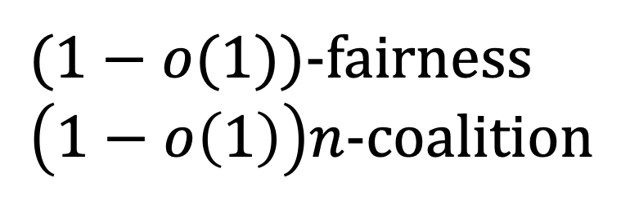
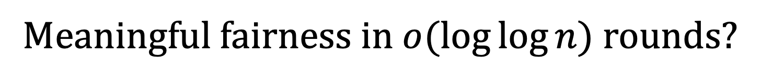
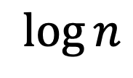
Meaningful fairness in $o(\log{\log{n}})$ rounds?
[CCWS21]
Tournament tree protocol
$(1−o(1))$-fairness
$\left(1−o\left(1\right)\right)n$-coalition
Perfect fairness
Arbitrary coalition
$$\log{\log{n}}$$
$$\log{n}$$
Notes:
So, there is a clear tradeoff here, between the round complexity, and the fairness and the size of the coalition we can tolerate. For over log n rounds, we can achieve perfect fairness and arbitrary coalition. For loglog n rounds we can achieve o(1)-fairness against (1-o(1))n-coalition. What if we want to aim for smaller round complexity? Can we still achieve meaningful fairness with o(loglog n) rounds?
This work gives an affirmative answer.

Slide 16
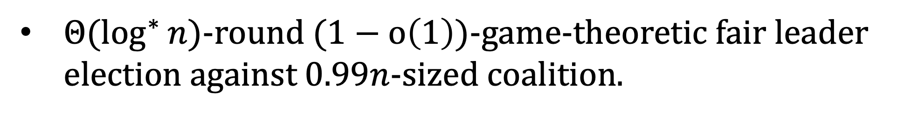
Our results
${Θ(log}^{∗}{n})$-round $(1−o\left(1\right))$-game-theoretic fair leader election against 0.99$n$-sized coalition.
Notes:
In this talk we are just going to focus on the log*n round leader election result.
So we basically have a very efficient leader election, that achieves good game theoretic fairness, against very large coalition that can be arbitrary constant fraction of corruption.

Slide 17
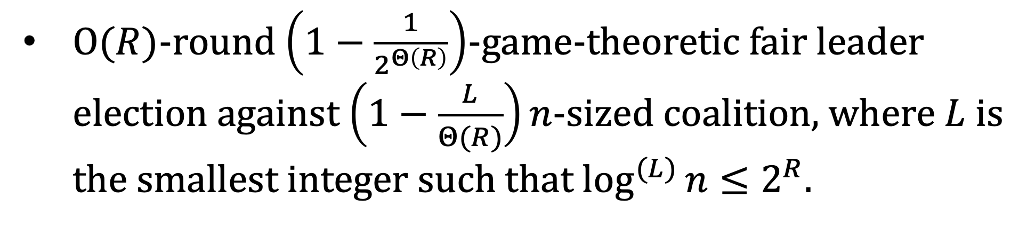
Our results: general parameter
$O(R)$-round $\left(1−\frac{1}{2^{Θ\left(R\right)}}\right)$-game-theoretic fair leader election against $\left(1−\frac{L}{Θ(R)}\right)n$-sized coalition, where $L$ is the smallest integer such that $\log^{(L)}{n}≤2^{R}$.
Notes:
In this paper, we also give a fully parametrized result of the tradeoff between round complexity, fairness parameter and the size of the coalition we can tolerate.

Slide 18


Final protocol
Commit-and-open lightest bin
Strawman:
Feige’s lightest bin variant
Notes:
Now let’s see how we get this fair leader election protocol.
We will start with a strawman solution that is a variant of Feige’s lightest bin protocol. We’ll see why it fails to achieve the fairness and we can fix the strawman solution with the commit and open lightest bin protocol, which is pretty much our final protocol, except that it still, has a remaining issue to fix. And after fixing this problem, we get our final leader election protocol.
In the rest of the talk, we will walk along this path together and see how we gradually develop our final leader election from the strawman solution.

Slide 19
Final protocol
Commit-and-open lightest bin
Strawman:
Feige’s lightest bin variant
Notes:
Now let’s see how we get this fair leader election protocol.
We will start with a strawman solution that is a variant of Feige’s lightest bin protocol. We’ll see why it fails to achieve the fairness and we can fix the strawman solution with the commit and open lightest bin protocol, which is pretty much our final protocol, except that it still, has a remaining issue to fix. And after fixing this problem, we get our final leader election protocol.
In the rest of the talk, we will walk along this path together and see how we gradually develop our final leader election from the strawman solution.

Slide 20






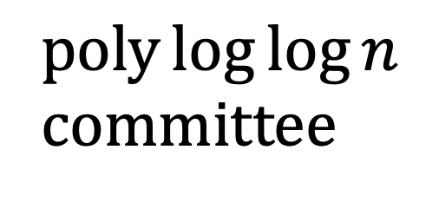
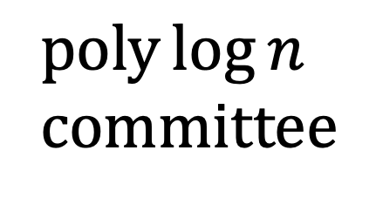
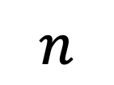
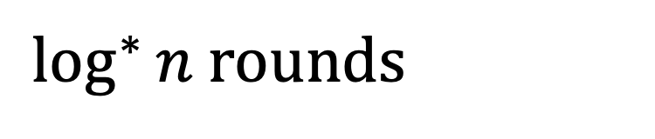
Feige’s lightest bin
$\log^{∗}{n}$ rounds
$$n$$
$poly\log{n}$ committee
$poly\log{\log{n}}$committee
[Feige99]
Notes:
First let’s recall how Feige’s lightest bin works.
He starts from n players and elect a preliminary committee of poly log n size.
Then he chooses a smaller committee of poly loglog n size from the preliminary committee, and he does this till there is only player left, which is our elected leader.
This takes log*n rounds of committee election where each committee election takes only constant rounds.

Slide 21

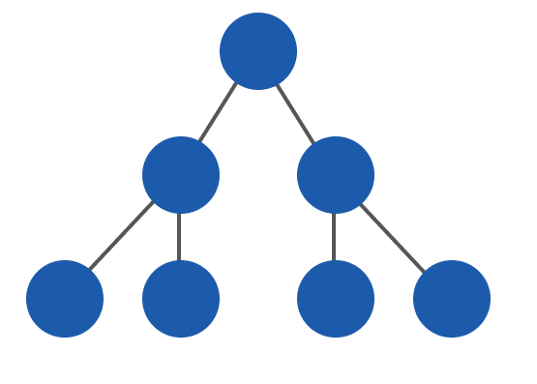
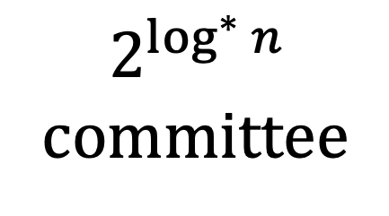
Strawman: stop at $2^{\log^{∗}{n}}$-committee and do tournament tree
$\log^{∗}{n}$ rounds
$$n$$
$poly\log{n}$ committee
$$2^{\log^{∗}{n}}$$
committee
Notes:
In our strawman solution, we also run several rounds of committee election as in Feige’s lightest bin protocol. The only difference is that we stop early when the committee size is roughly 2^log*n. We stop here and switch to the tournament tree protocol.
I’ll explain the technical reason of stopping early and switch to tournament tree later.
In the strawman solution, we run no more than log*n number of committee election and a log*n round of touanrment tree protocol.
So in total, the round complexity is log*n.

Slide 22
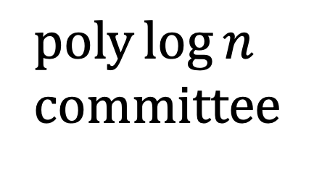
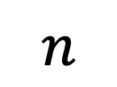
$$n$$
$poly\log{n}$ committee
Notes:
Now the remaining thing is how we do the committee election.
As long as the committee election satisfies game theoretic fairness, then the final leader election protocol satisfies game theoretic fairness.
i.e., a coalition cannot increase its probability of being elected into the committee and harm the probability of an honest player being elected into the committee by too much.
From now on we will just focus on this one step of committee election.

Slide 23





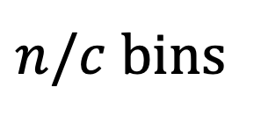
Lightest bin: electing c-sized committee
$n/c$ bins
Notes:
Suppose we want to elect a committee of size at most c from n players, where the orange players are corrupted players and gray players are honest. Which is polylog n in our case, let every player uniformly random choose one bin from n/c bins. Players in the lightest bin are chosen as the committee.

Slide 24




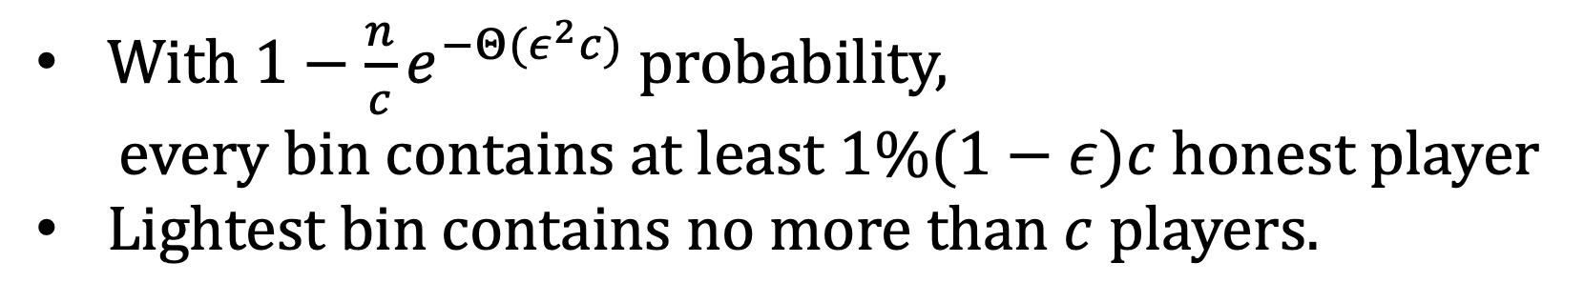
With $1−\frac{n}{c}e^{−Θ(ε^{2}c)}$ probability,
every bin contains at least $1\%(1−ε)c$ honest player
Lightest bin contains no more than $c$ players.
Notes:
By Chernoff bound, number of honest players in each bin should concentrate around the average, which is 1%.
So with a large probability, every bin contains many honest players. Specifically, every bin contains at least 1%(1-\epsi)c honest players.
Now the lightest bin contains at most c players, so the fraction of corrupted players in the lightest bin must be close to 99%.

Slide 25


Notes:
Players in the lightest bin are chosen as the committee.

Slide 26

can look at
bins and decide their own
Notes:
Since the coalition can perform rushing attack, they can look at honest players bin choices and then decide their own bin choices.

Slide 27

Large coalition cannot benefit too much w. p. $1−\frac{n}{c}e^{−Θ(ε^{2}c)}$
must stop
early
~99% corrupted
Notes:
Therefore, no matter how the coalition distribute themselves, the fraction of coalition in the lightest bin is roughly same as before.
So the strawmen solution actually guarantees that a lagre coalition cannot benefit too much, with a large probability.
This is actually the reason that we have to stop early and switch to tournament tree protocol. If we run the committee election as in Feige’s lightest bin protocol all the way till the end, then in the last few rounds, this probability becomes a small probability compared to n, which is basically a constant probability in the last few rounds. And that ruins our fairness requirements because in the last few rounds the large coalition can gain significant benefit with a constant probability. So we have to stop early when this probability is still reasonably large and switch to the tournament tree protocol

Slide 28
Large coalition cannot benefit too much w. p. $1−\frac{n}{c}e^{−Θ(ε^{2}c)}$
How about small coalition?
Small coalition can gain significant advantage
Notes:
Surprisingly, in the strawman solution, a small coalition can gain significant advantange.
This is conter intuitive that the strawman is fair against large coalition but not for small coalition

Slide 29
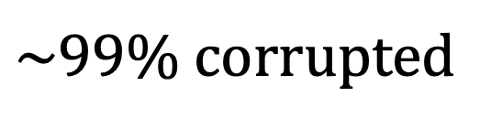
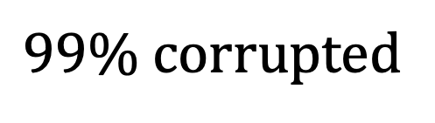
$99\%$ corrupted
$\sim 99\%$ corrupted
Notes:
If the coalition is 0.9n sized, then in the committee the fraction of the corrupted player is still roughly 0.9n.
Thus, if honest players distribute themselves kinds of evenly, which happens with this probability, then a large coalition cannot benefit.
However, if honest player don’t distribute themselves evenly, then the coalition can take arbitrary fraction of the committee.
This is exactly the reason that we have to stop early and switch to tournament tree protocol: if we do it till the end as in Feige’s protocol, then the probability that honest player does not distribute evenly becomes a constant, and the coalition has a constant probability of taking arbitrary fraction of the committee.

Slide 30
Notes:
Let’s see how a small coalition can gain benefit.
Let's assume that there is only one corrupted player.

Slide 31

can look at
bins and decide its own
Notes:
After honest players make their bin choices, the corrupted player can look at honest players’ bin choices and then decide its own bin choice.
If the honest players are distributed as in the slides, then a rational strategic player will of course, choose the last bin.

Slide 32
elected in the committee with high probability
Notes:
And it will be included in the committee.
In general, this attack can be performed as long as the second lightest bin contains two more players than the lightest bin, which happens with high probability

Slide 33
Final protocol
Commit-and-open lightest bin
Strawman:
Feige’s lightest bin variant

Slide 34



2nd try: commit-and-open lightest bin
Hide the bin choices!
has to choose its bin independently from
Notes:
The corrupted player can perform this attack basically because it can choose its bin based on honest players bin choices.
So to fix this problem, we come to our second try, which is to hide the bin choice.
We first let each player commits to its bin choice.
Now the corrupted player has to commit to its own bin independently from honest players bin choices because the commitments hide the honest players bin choices.

Slide 35

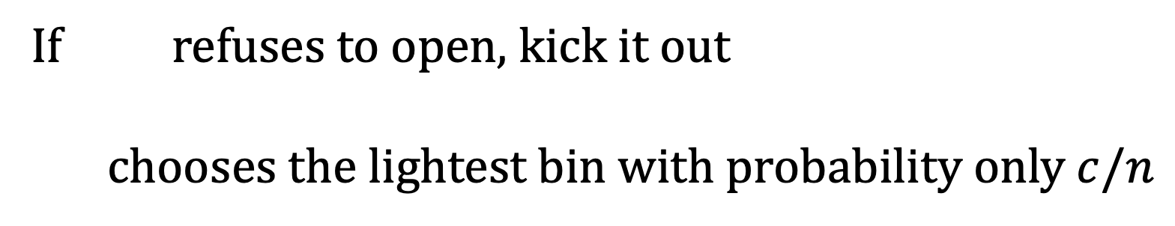
If refuses to open, kick it out
chooses the lightest bin with probability only $c/n$
Notes:
Now after the honest players open their bin choices,
The corrupted player can only choose not to open, or reveal the bin choice it commits to.
Since it chooses its bin before seeing honest players bin choice, it can only hit the lightest bin with probability c/n. so it can only be elected into the committee with probability c/n, and this is exactly what we want.

Slide 36
Commit-and-open lightest bin
No coalition can noticeably increase its expected fraction in the lightest bin.
They can harm an honest individual.
Notes:
As long as the coalition size does not exceeds 99%.
However, as I mentioned to you, this is almost the final protocol, but it has a remaining issue.

Slide 37
Notes:
To see how the coalition can harm an honest individual, let’s say this black player in the circle is an honest player the coalition wants to attack.
The coalition can just distribute themselves as even as possible into the bins.

Slide 38
can look at
openings and decide which to open
Notes:
Then they look at the honest players openings of bin choices, and they see that the honest target chooses bin 3.
Now they can decide which commitments to open.

Slide 39


can look at
openings and decide which to open
Notes:
As we mentioned, if a player refuse to open its commitment, it will be kicked out. So the coalition can choose to refuse to open these two commitments choosing bin 1 and be kicked out.

Slide 40
can look at
openings and decide which to open
Notes:
Now bin 1 is the lightest bin, so the honest target cannot be elected into the committee, because the coalition tries so hard to exclude it.

Slide 41
Final protocol
Commit-and-open lightest bin
Strawman:
Feige’s lightest bin variant
Notes:
Due to the time constraints I’m only going to talk about the very high level idea used in our final protocol.

Slide 42



Final protocol
Virtual ID!
$$…$$
1
2
3
$$n$$
Notes:
We want to use the virtual ID technique in CCWS21, and players use virtual ID to do the commit and open lightest bin.

Slide 43
Commit and open with virtual ID
1
…
3
can only see bin choices of honest virtual IDs
doesn’t know who to exclude!
Notes:
Now the coalition only sees the bin choices of virtual IDs,
As long as the coalition does not know the mapping between the real identity and the virtual ID, which is done by commitments, then the coalition doesn’t know who to exclude.

Slide 44
1
…
3
5
7
8
Notes:
Only after the lightest bin with virtual IDs inside is fixed, players open the commitments of their virtual ID. And those whose virtual ID is in the lightest bin are chosen as the committee.

Slide 45
1
…
3
5
7
8
doesn’t know who to exclude!
Notes:
Note that the coalition only sees the bin choice of an honest virtual ID, 1 or 3, they don’t know who is behind this virtual ID, because the mapping between the real ID and virtual ID is hidden by the commitments.
So the corrupte players don’t know who to exclude, and thus they can not harm an honest individual by too much, and we can achieve game theoretic fairness by doing commit and open with virtual ID.

Slide 46

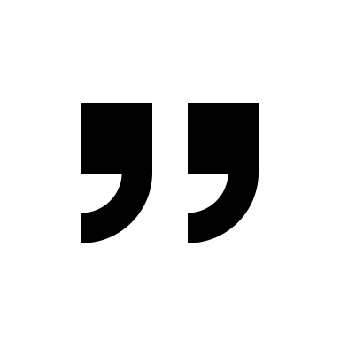


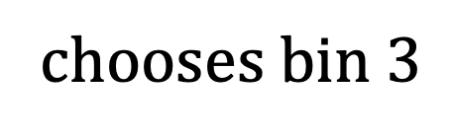
When
opens bin choice
Virtual ID
3
chooses bin $3$
Gotcha!
Notes:
However, in our case, we cannot just simply do the virtual ID trick as in Chung et al. Because our ptocol runs in an authenticated broadcast channel where everyone knows the identity of the sender of a message.
When the honest target sends messge on behalf of its virtual ID, the coalition knows who sends the message and they can map the real ideneity and the virtual IDs.

Slide 47
Anonymous broadcast for commit and open!
Anonymous Broadcast Channel
Notes:
To deal with this problem, we need an anonymous broadcast channel, so that after each honest player broadcast some messages, the coalition doesn’t know who post the message.

Slide 48
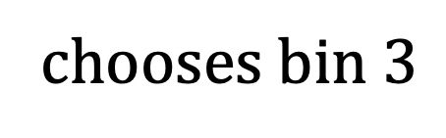
Anonymous broadcast for commit and open!
Anonymous Broadcast Channel
Virtual ID
3
chooses bin $3$
Notes:
Thus we need an anonymous broadcast channel that hides the identity of the sender of each message, and thus hide the mapping between real identity and virtual ID of honest players.

Slide 49
Commit-and-open with virtual ID via anonymous broadcast
No coalition can noticeably increase its expected fraction in the lightest bin.
No coalition can noticeably harm an honest individual.
Notes:
Now with this anonymous broadcast channel, it is really true that the coalition doesn’t know who to target and we can achieve game theoretic fairness.

Slide 50
More in paper
Game-theoretically fair committee election.
Notes:
In the paper, we also give a fully parametrized fair committee election for arbitrary sized committee.

Slide 51
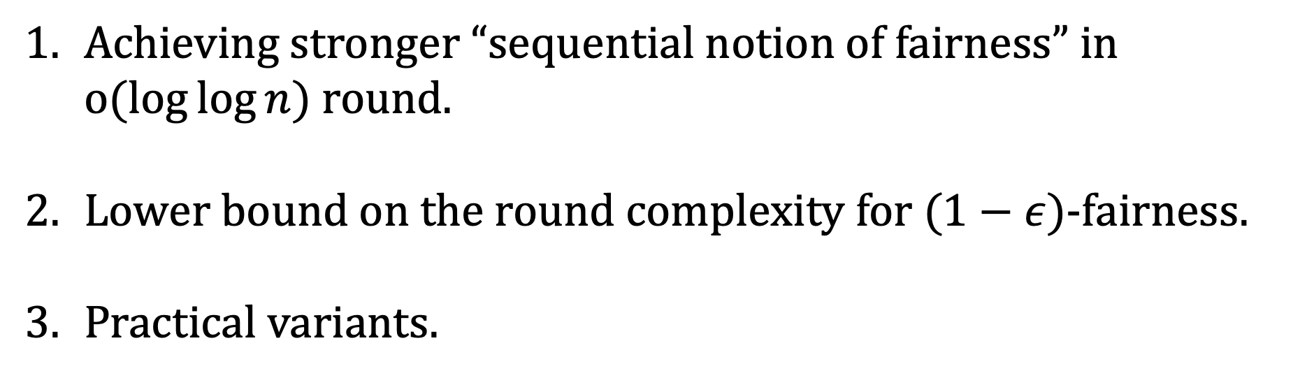
Open Questions
Achieving stronger “sequential notion of fairness” in $o(\log{\log{n}})$ round.
Lower bound on the round complexity for $(1−ε)$-fairness.
Practical variants.
Thank you!
eprint: 2022/791
kew2@andrew.cmu.edu
Notes:
Our work does not satisfy the strong sequential notion of fairness as achieved whereas the leader election in CCWS21 satisfies this stronger notion. It requires that at any point in the protocol, given the current information, the coalition does not want to deviate.

