Slide 1
Mechanism Design for
Automated Market Makers
T-H. Hubert Chan (HKU), Ke Wu (CMU and UMich), Elaine Shi (CMU)
AFT 2025

Slide 2
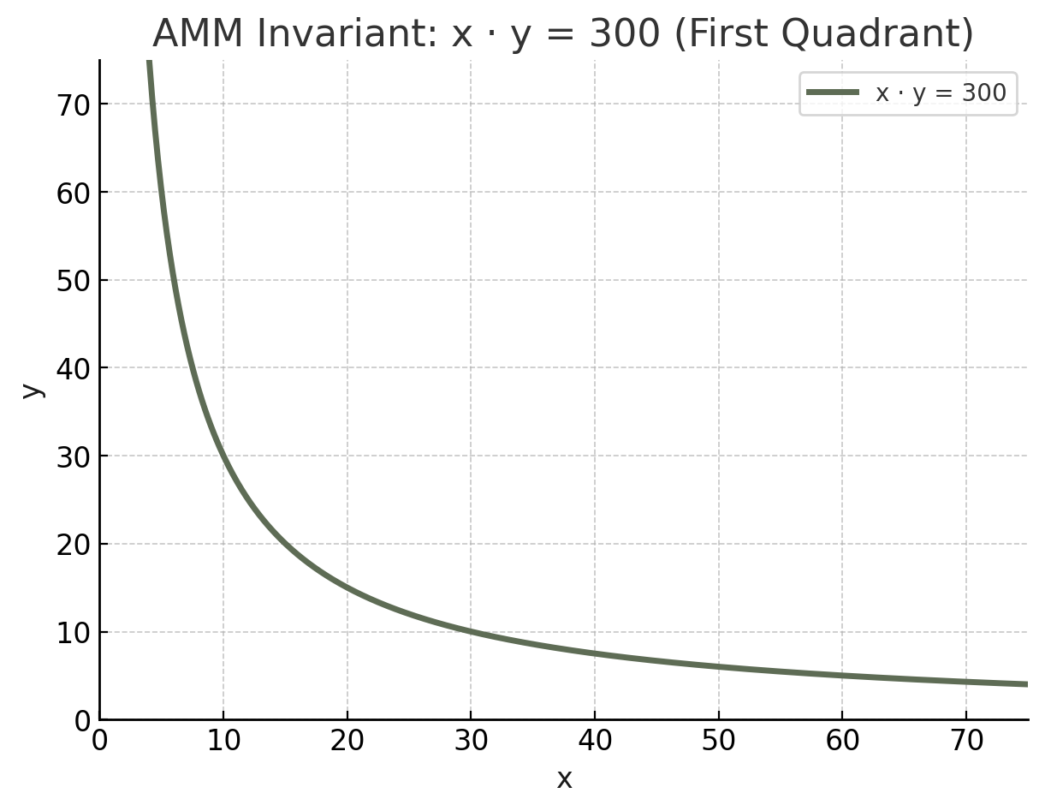



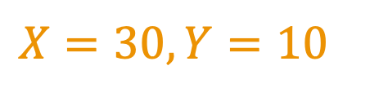

Automated market maker (AMM)
$$X⋅Y=300$$
Y
X
$$X=30, Y=10$$
30 apple
10 cherry
Constant product AMM

Slide 3
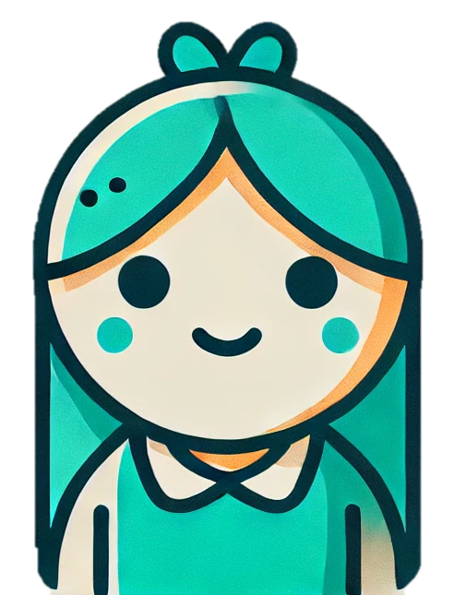
Automated market maker (AMM)
$$X⋅Y=300$$
Buy 10 apple
Pay 5 cherry

Slide 4

Maximal extractable value (MEV)
$$X⋅Y=300$$
Buy 15 apple
Pay 10 cherry
Buy 10 apple
Pay 40 cherry
Sell 15 apple
Get 45 cherry
Gain 35 cherry at no risk!
Notes:
However, on blockchain, users’ orders are first group into blocks by block producer or we just it miner before being confirmed and executed.
Such unilateral power of the miner allow them to exploit the users and gain profit.

Slide 5
MEV: one of the most important challenges
Exploit users
Undermines the stability and security of consensus
Lead to off-chain economy and centralizing effect
…

Slide 6
Consensus can’t eliminate MEV
Solving MEV entirely at the consensus layer is impossible with today’s architecture
[Bahrani, Garimidi, Roughgarden 24], [Ferreira and Parkes 23]
Strengthened guarantees at the consensus layer
  Sequencing fairness
  Encrypted mempool
  ...
Little formal investigation on how AMM benefits
Notes:
It would be the ideal case if we can eliminate MEV at the consensus layer, without having to modify the existing applications. However, this is impossible.

Slide 7
Can we rely on mechanism design at the application level for provable MEV resilience?
How do strengthened properties at consensus layer help design mechanisms at the application layer?

Slide 8
Our results: AMM
In the plain model (sequencing controlled by miner)
Arbitrage-resilience: No arbitrageur can gain risk-free profit.
In weak fair-sequencing model (sequencing via arrival time)
Strategy-proofness: No strategic behavior gives strictly better outcome than honest strategy.
Notes:
Our mechanism offers two tiers of guarantees depending on the properties of the underlying consensus.
Even when the block producer has unilateral control over block contents and transaction ordering
As a heads up, our mechanism processes orders in batches and guarantees the invariant of the pool before and after executing the whole batch
I will use constant-product market maker as an example to demonstrate the main idea, but our mechanism extends to general increasing differentiable and concave potential function as well

Slide 9
Roadmap
Arbitrage-resilience
  Swap mechanism in the plain model
  Our mechanism
Strategy-proofness
  Weak fair-sequencing model
  How our mechanism achieves strategy-proofness
Notes:
Throughout this talk I will focus on constant product AMM for easier understanding, but our mechanism allows other general types of potential function as long as it is increasing, differentiable and concave.

Slide 10

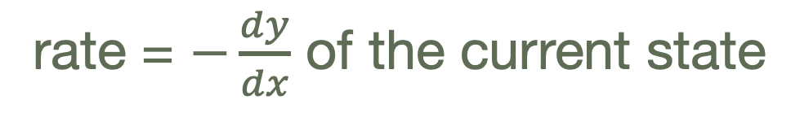

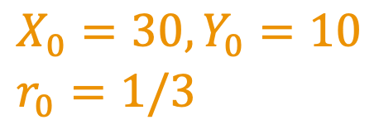
Swap mechanism: pool
$$X⋅Y=300$$
$X_{0}=30, Y_{0}=10$
$r_{0}=1/3$
rate = $−\frac{dy}{dx}$ of the current state
Notes:
How much Y one needs to pay from the current state of the pool for infinitesimal amount of X asset.

Slide 11
Swap mechanism: order
(Buy/Sell X, volume, r, aux_info)

Slide 12

Swap mechanism: order
(Buy/Sell X, volume, r, aux_info)
Maximum amount a user wants to buy/sell
We allow partial fulfillment
Notes:
Generally it comes from information asymmetrie created by power structures

Slide 13
Swap mechanism: order
Acceptable exchange rate:
(Buy/Sell X, volume, r, aux_info)
Buy X: execute at rate no greater than r
Sell X: execute at rate no smaller than r
Notes:
Generally it comes from information asymmetrie created by power structures

Slide 14
Swap mechanism: order
(Buy/Sell X, volume, r, aux_info)
Auxiliary information such as identity, submission time, arrival time, etc.

Slide 15
Plain model
Strategic user can submit multiple orders, misreport.
Strategic miner can inject orders, censor honest users’ orders, arbitrarily sequencing.
Notes:
Generally it comes from information asymmetrie created by power structures

Slide 16
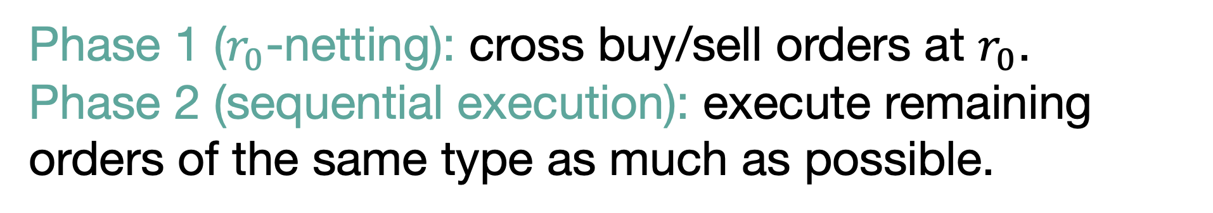
Our mechanism
Initial rate $r_{0}=\frac{1}{3}, X_{0}=30, Y_{0}=10$
(Buy X, 12, 0.6)
(Buy X, 11, 0.5)
(Buy X, 10, 0.75)
(Sell X, 6, 0.2)
(Sell X, 12, 0.3)
Phase 1 ($r_{0}$-netting): cross buy/sell orders at $r_{0}$.
Phase 2 (sequential execution): execute remaining orders of the same type as much as possible.
Notes:
Aux info is not important here so I’m ommitting it.

Slide 17
Our mechanism: phase 1
Initial rate $r_{0}=\frac{1}{3}$
(Buy X, 12, 0.6)
(Buy X, 11, 0.5)
(Buy X, 10, 0.75)
(Sell X, 6, 0.2)
(Sell X, 12, 0.3)
Phase 1 ($r_{0}$-netting):
Notes:
Generally it comes from information asymmetrie created by power structures

Slide 18
Our mechanism: phase 1
Initial rate $r_{0}=\frac{1}{3}$
(Buy X, 12, 0.6)
2a. (Buy X, 6, 0.5)
2b. (Buy X, 5, 0.5)
(Buy X, 10, 0.75)
(Sell X, 6, 0.2)
(Sell X, 12, 0.3)
Phase 1 ($r_{0}$-netting)
Notes:
Generally it comes from information asymmetrie created by power structures

Slide 19
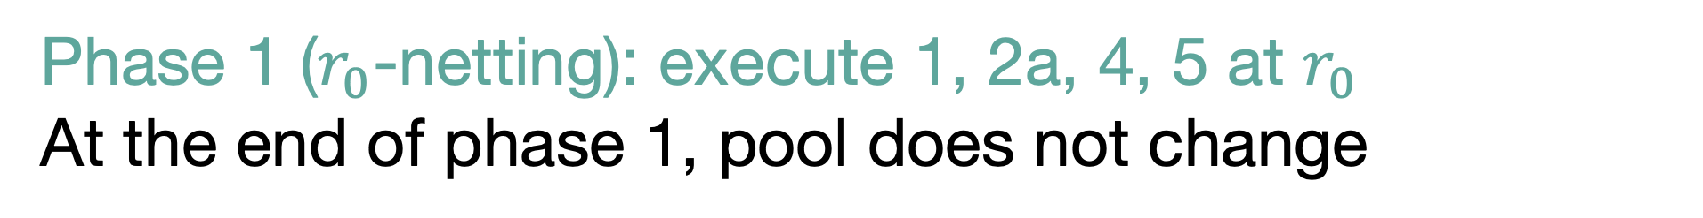
Our mechanism: phase 1
Initial rate $r_{0}=\frac{1}{3}$
(Buy X, 12, 0.6)
2a. (Buy X, 6, 0.5)
2b. (Buy X, 5, 0.5)
(Buy X, 10, 0.75)
(Sell X, 6, 0.2)
(Sell X, 12, 0.3)
Phase 1 ($r_{0}$-netting): execute 1, 2a, 4, 5 at $r_{0}$
At the end of phase 1, pool does not change
Notes:
Generally it comes from information asymmetrie created by power structures

Slide 20
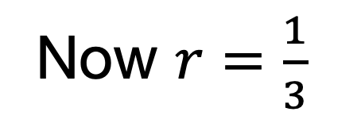
Our mechanism: phase 2
Now $r=\frac{1}{3}$
2b. (Buy X, 5, 0.5)
(Buy X, 10, 0.75)
Phase 2 (sequential execution): execute as much as possible
Notes:
Generally it comes from information asymmetrie created by power structures

Slide 21
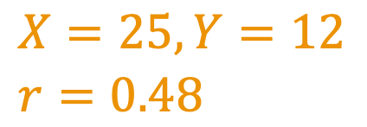
Our mechanism: phase 2
Now $r=\frac{1}{3}$
2b. (Buy X, 5, 0.5)
(Buy X, 10, 0.75)
$X=25, Y=12$
$r=0.48$
Phase 2 (sequential execution): execute as much as possible
Notes:
Generally it comes from information asymmetrie created by power structures

Slide 22
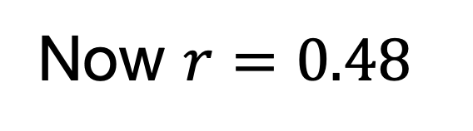
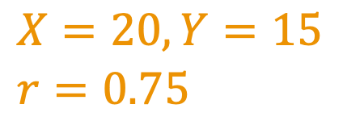
Our mechanism: phase 2
Now $r=0.48$
(Buy X, 10, 0.75)
partially fulfilled: gets 5 X
$X=20, Y=15$
$r=0.75$
Phase 2 (sequential execution): execute as much as possible
Notes:
Generally it comes from information asymmetrie created by power structures

Slide 23
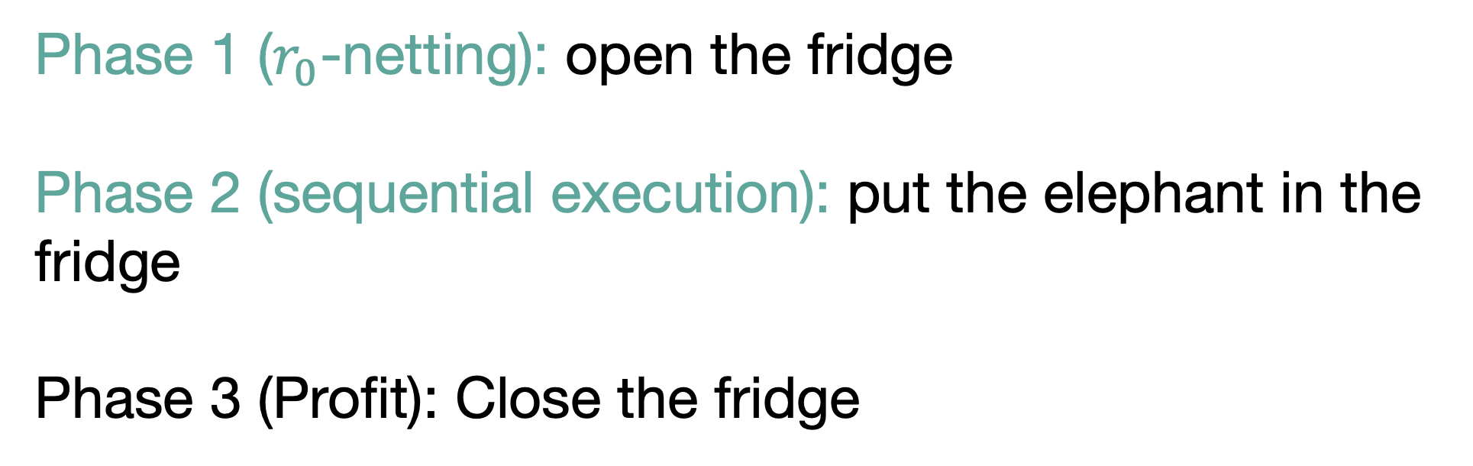
Our mechanism
Phase 1 ($r_{0}$-netting): open the fridge
Phase 2 (sequential execution): put the elephant in the fridge
Phase 3 (Profit): Close the fridge
Notes:
Generally it comes from information asymmetrie created by power structures

Slide 24
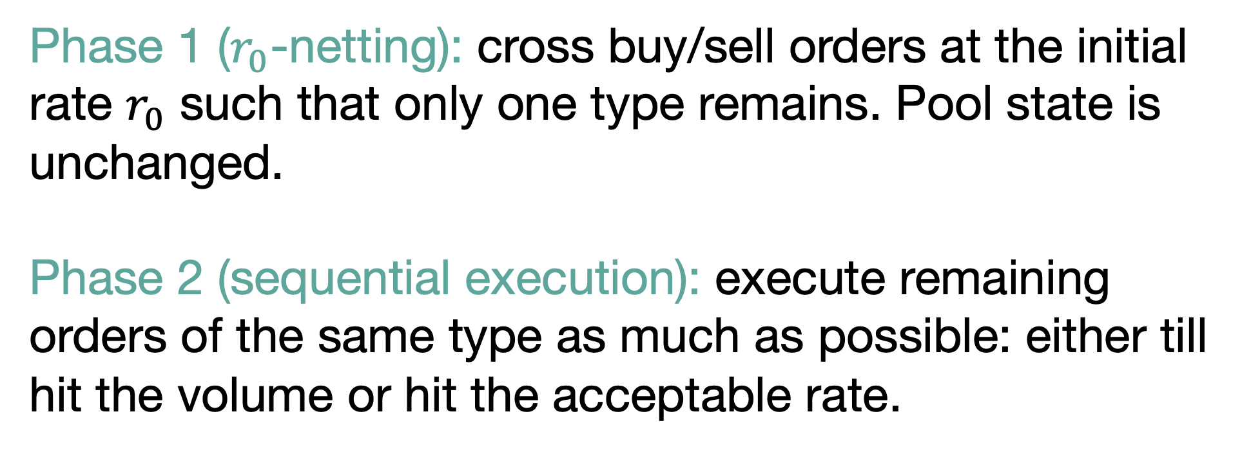
Our mechanism
Phase 1 ($r_{0}$-netting): cross buy/sell orders at the initial rate $r_{0}$ such that only one type remains. Pool state is unchanged.
Phase 2 (sequential execution): execute remaining orders of the same type as much as possible: either till hit the volume or hit the acceptable rate.
Notes:
Generally it comes from information asymmetrie created by power structures

Slide 25
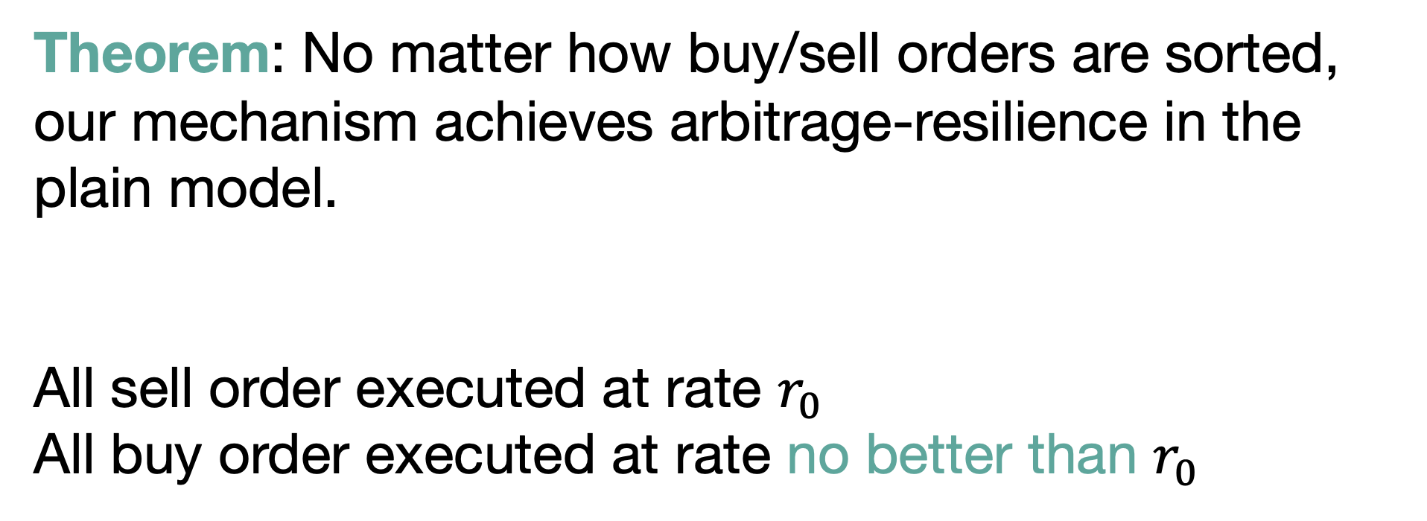
Arbitrage-resilience
Theorem: No matter how buy/sell orders are sorted, our mechanism achieves arbitrage-resilience in the plain model.
All sell order executed at rate $r_{0}$
All buy order executed at rate no better than $r_{0}$
Notes:
Generally it comes from information asymmetrie created by power structures

Slide 26
Not strategy-proof in plain model
If aux_info used for sorting
User can lie about aux_info
Miner can censor honest users’ orders
Notes:
Orders appear first enjoys a better price.

Slide 27
Roadmap
Arbitrage-resilience
  Swap mechanism in the plain model
  Our mechanism
Strategy-proofness
  Weak fair-sequencing model
  How our mechanism achieves strategy-proofness
Notes:
Our mechanism offers two tiers of guarantees depending on the properties of the underlying consensus.
Even when the block producer has unilateral control over block contents and transaction ordering
I will use constant-product market maker as an example to demonstrate the main idea, but our mechanism extends to general increasing differentiable and concave potential function as well

Slide 28
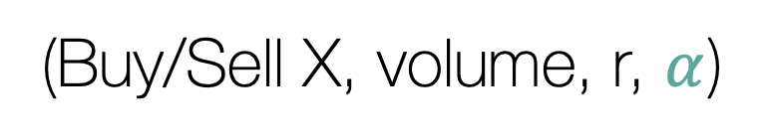
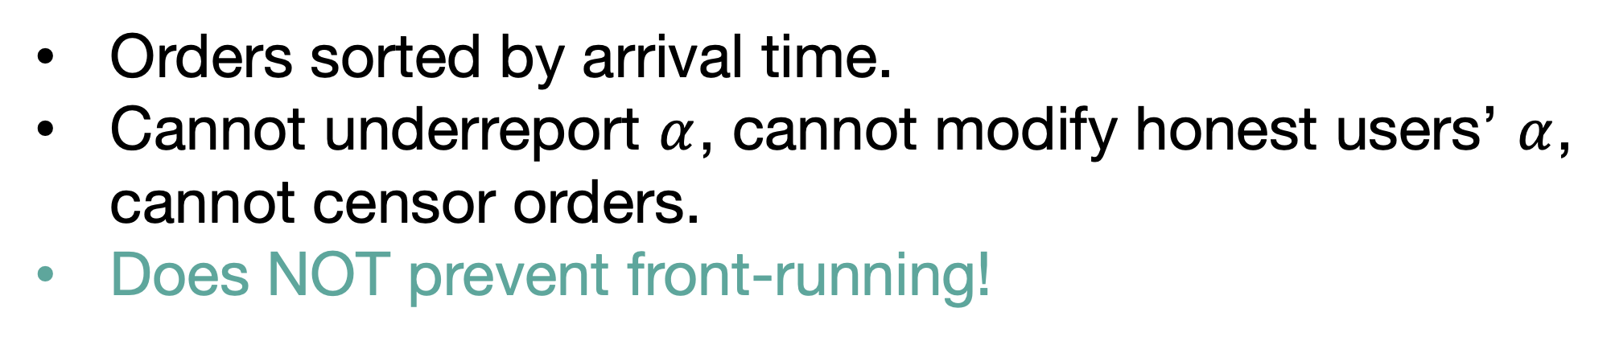
Weak fair-sequencing model
(Buy/Sell X, volume, r, $α$)
Encodes arrival time: submission time + delay
Orders sorted by arrival time.
Cannot underreport $α$, cannot modify honest users’ $α$, cannot censor orders.
Does NOT prevent front-running!
Notes:
Because sequencing is now determined by the underlying decentralized sequencer.

Slide 29
Weak fair-sequencing model
(Buy X, 12, 0.6, 1)
(Buy X, 11, 0.5, 4)
(Buy X, 10, 0.75, 5)
(Sell X, 6, 0.2, 2)
(Sell X, 12, 0.3, 3)
Notes:
Generally it comes from information asymmetrie created by power structures

Slide 30
Strategy-proofness
No strategy is strictly better than honest strategy.
Honest: one order, (true type, true demand, true belief of current rate, true arrival time).
Strictly better: within true demand, subject to true belief, prefer to be executed as much as possible.
Notes:
The more the better, subject to my acceptable rate.

Slide 31
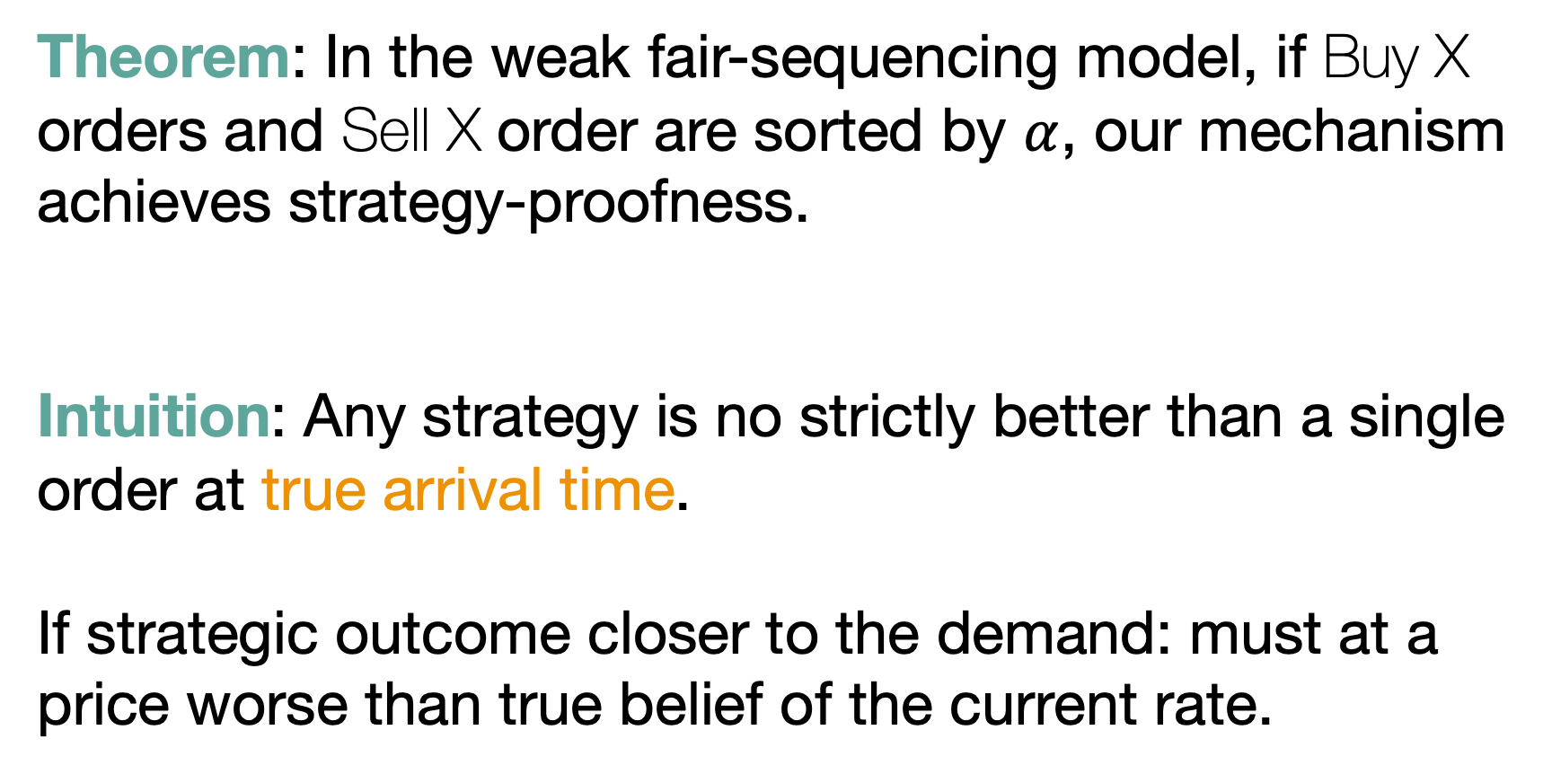
Strategy-proofness
Theorem: In the weak fair-sequencing model, if Buy X orders and Sell X order are sorted by $α$, our mechanism achieves strategy-proofness.
Intuition: Any strategy is no strictly better than a single order at true arrival time.
If strategic outcome closer to the demand: must at a price worse than true belief of the current rate.
Notes:
Generally it comes from information asymmetrie created by power structures

Slide 32
Conclusion
Two-phase swap mechanism for AMM
Arbitrage-resilience in the plain model
Strategy-proofness in the weak fair-sequencing model
Notes:
Our mechanism offers two tiers of guarantees depending on the properties of the underlying consensus.
Even when the block producer has unilateral control over block contents and transaction ordering
I will use constant-product market maker as an example to demonstrate the main idea, but our mechanism extends to general increasing differentiable and concave potential function as well

Slide 33
Open questions
Extension to multiple assets.
Strategy-proofness without relying on sequencing fairness.
All-or-nothing fulfillment.

Slide 34
Thank you!

